Slide 1
EIS 2018 IR&D
EIS Axios: Cloud Computing Data Processing
2018
Project Status

Slide 2
Cloud Computing Data Processing Project Summary
Project Overview
Technical Approach
With their stated intentions to migrate data processing to cloud computing architectures such as IC-ITE, continued viability with our customers requires that we develop tools and approaches to operate in the cloud environment.
The Cloud Computing Data Processing IRAD will take advantage of components, such as EC2, RDS, EMR, and CloudWatch, provided by cloud computing services for resource allocation
The goal is to create an engine and a framework that will facilitate the addition and integration of processing modules for data analysis and dissemination
Most of the framework development is covered under the Seven Hills contract. Same framework will be used in this IRAD
The end product will provide:
Graphical User Interface to configure the system and to manage components
All basic modules to interact with the different components from the cloud provider
A set of API to quickly develop and integrate custom modules to be used on a system
An engine that will tie them together
Better integrated NiFi application
Integration with search engines such as Elastic Search and Kibana
We propose implementing this IRAD to be cloud agnostic, but tested on AWS. We think this approach is reasonable because of some important government implementations of IC-ITE, such as C2S and GovCloud, are built on AWS.
Back-End Framework Development
Continue with the testing and bug fixing of the current framework.
Front-End GUI Development
Develop a front-end or GUI to allow users to manage modules as well as to command and control running threads
Incorporate a configuration page to facilitate system administration
Incorporate the use of Lambda functions
NiFi Integration
Continue the NiFi Integration to allow selection of target resource for task allocation.
Elastic Search / Kibana
Incorporate Elastic Search and Kibana to the framework for data analysis.
2
Notes:
07/29/17
2

Slide 3
ASSETS: Cloud Computing Accomplishments
Back-End Framework Development
Created a white paper explaining CCDP goals for patent submission
Continue testing and integration with front-end GUI.
Implemented a mock virtual environment to facilitate testing
Front-End GUI Development
Enabled adding new modules to the framework
Allowing users to upload and configure custom modules
Improvements to the GUI is being done on a need basis
Elastic Search
All CCDP Agents heartbeats are now stored in a ElasticSearch database.
Added web application to query and monitor real-time overall status of the cluster
Adding more features and views to the web application
Other Tools Integration
None.

Slide 4
ASSETS: Cloud Computing Financial Status

Slide 5
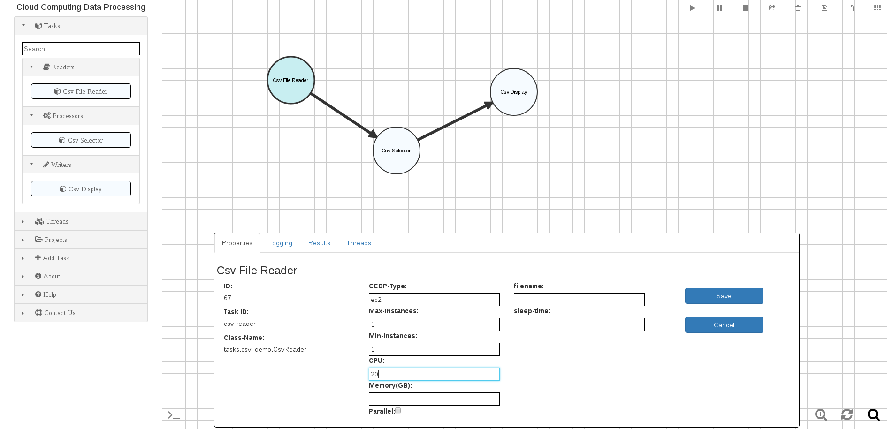
ASSETS: Cloud Computing Background Information: Graphical User Interface

Slide 6
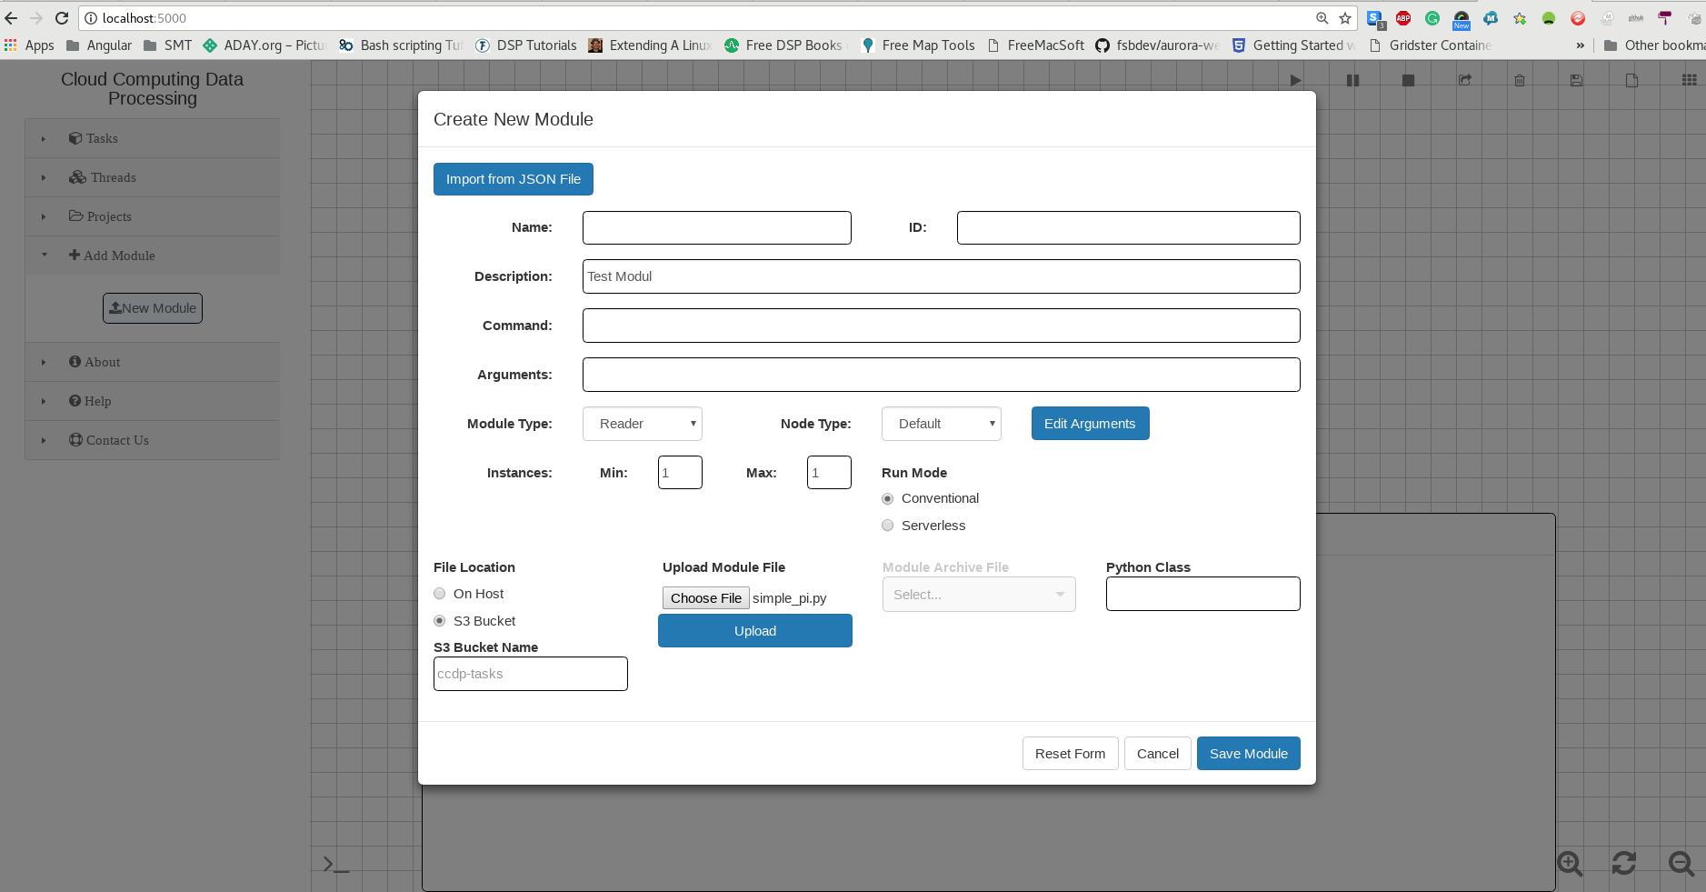
ASSETS: Cloud Computing New Module

Slide 7
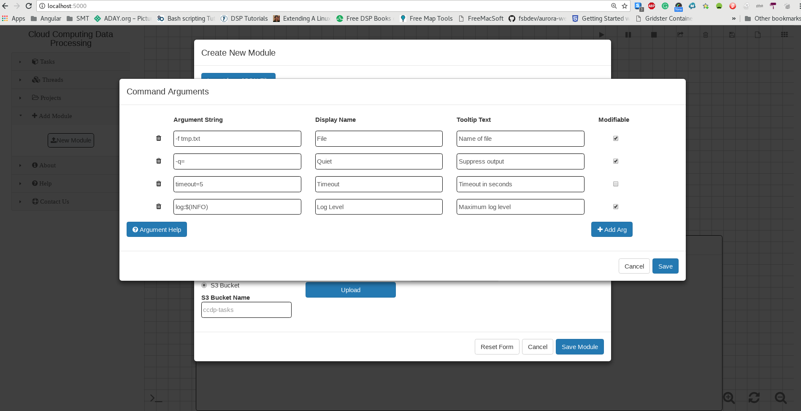
ASSETS: Cloud Computing Module Arguments

Slide 8
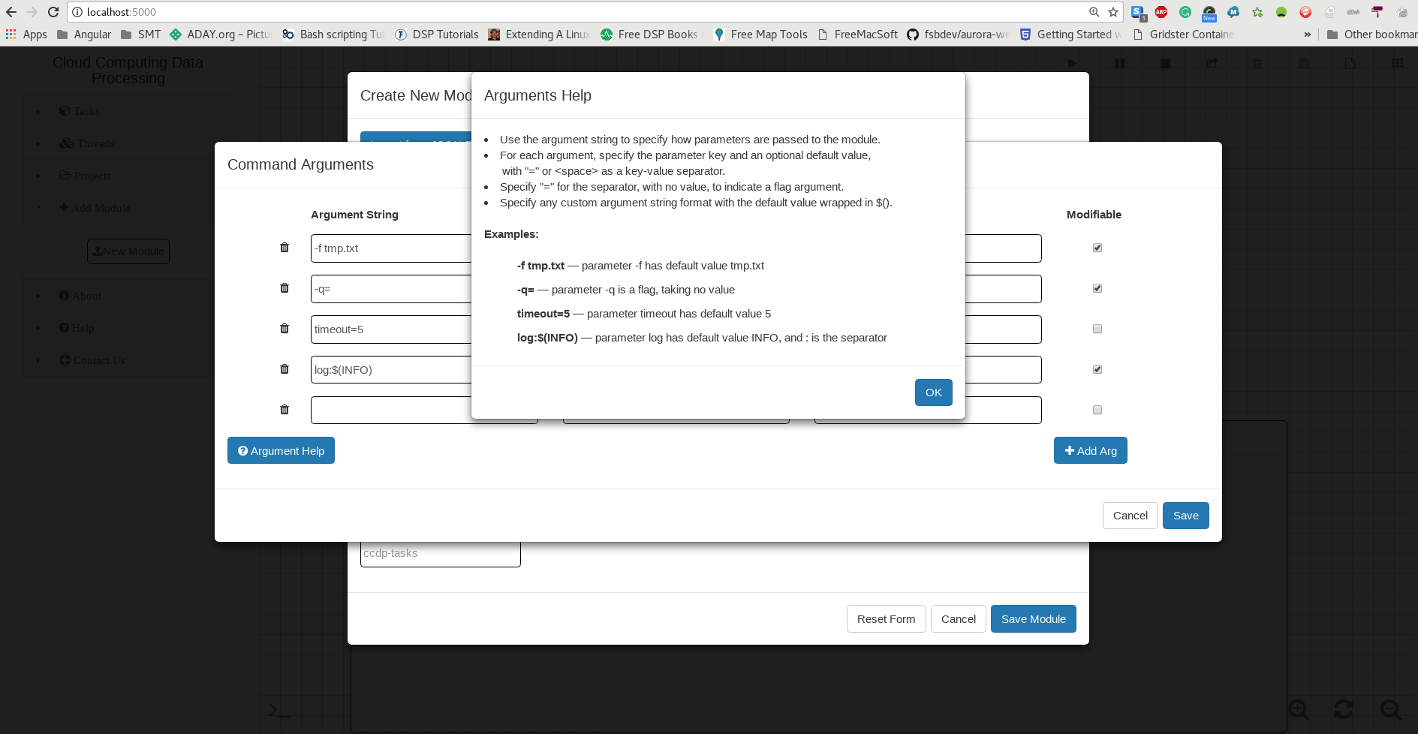
ASSETS: Cloud Computing Arguments Help

Slide 9
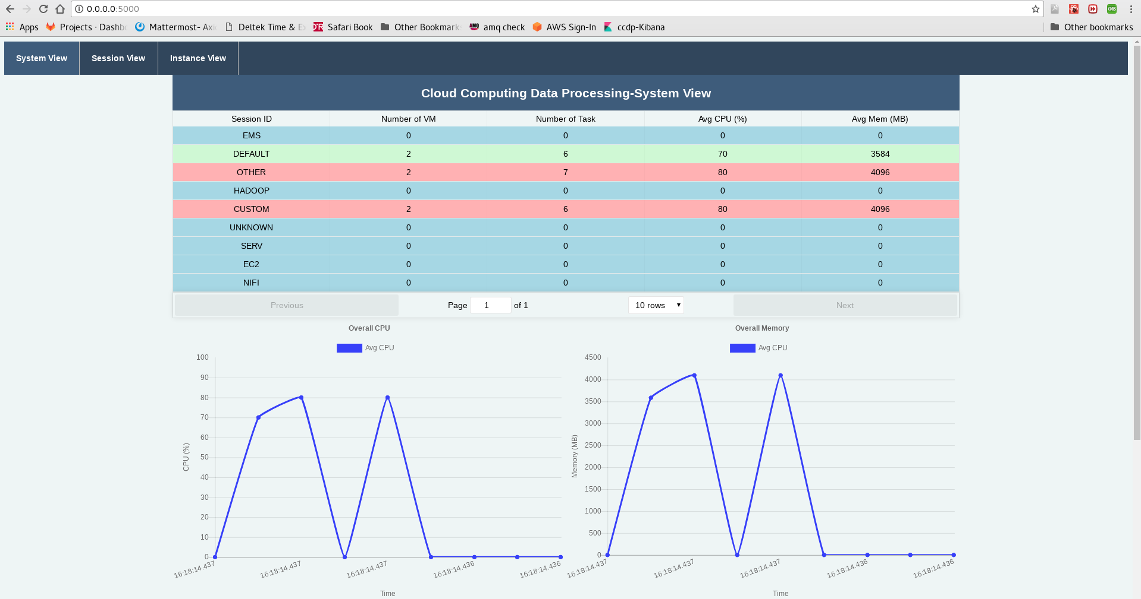
ASSETS: Cloud Computing Background Information: Status Page
Need New Image From Tatiana

Slide 10
ASSETS: Cloud Computing Next Steps
Keep working on uploading, editing, and removing modules through the GUI
Enable system administrators to configure the framework through the web
Create a configuration page to configure the framework
Facilitate access to the elastic search database to the modules
Continue incorporating additional big data processing into the framework
Continue the framework testing and development
Explore possible uses inside and outside LGS

